Slide 1
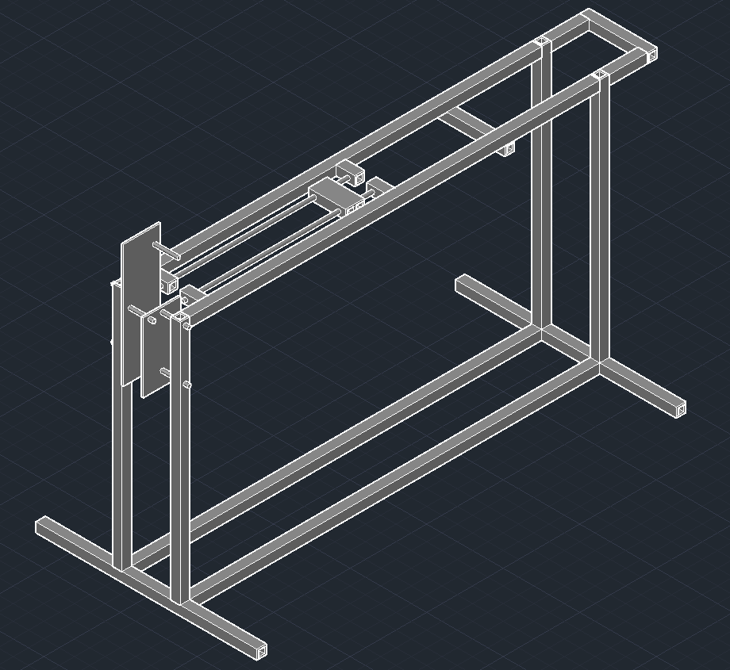
Mech ArcherThis ain't your daddy's bow
(insert another picture)
Imagine RIT exhibit
Arduino driven
Contact bmb8610@rit.edu for more info
Notes:
Style left blank since you're adding this to another presentation

